Slide 1



Linux Admin I
Chapter 08
Presented by: Mohamed Fakhruldeen

Slide 2

08.C Killing Processes
• Use commands to kill and communicate with processes.
• Define the characteristics of a daemon process.
• End user sessions and processes.

Slide 3
PROCESS CONTROL USING SIGNALS
A signal is a software interrupt delivered to a process. Signals report events to an executing
program. Events that generate a signal can be an error, external event (such as an I/O request or
an expired timer), or by explicit request (the use of a signal-sending command or by a keyboard
sequence).

Slide 4
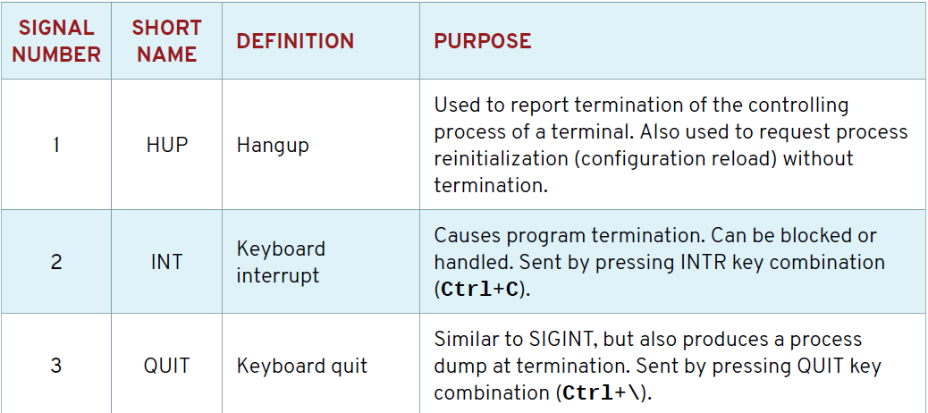
Fundamental Process Management Signals

Slide 5
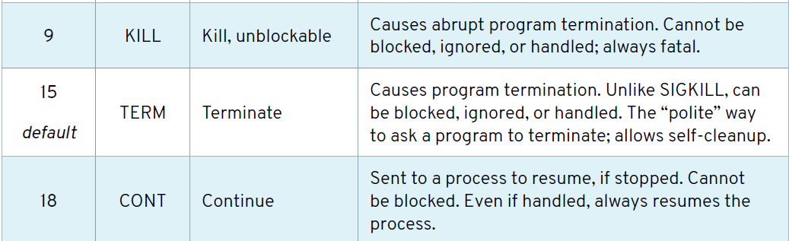
Fundamental Process Management Signals

Slide 6
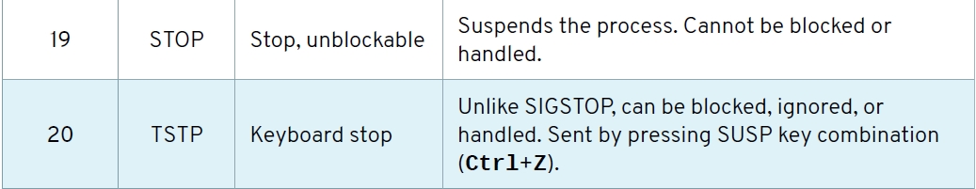
Fundamental Process Management Signals

Slide 7
Fundamental Process Management Signals
Each signal has a default action, usually one of the following:
• Term - Cause a program to terminate (exit) at once.
• Core - Cause a program to save a memory image (core dump), then terminate.
• Stop - Cause a program to stop executing (suspend) and wait to continue (resume).

Slide 8


Sending Signals by Explicit Request
[user@host ~]$ kill -l
1) SIGHUP 2) SIGINT 3) SIGQUIT 4) SIGILL 5) SIGTRAP
6) SIGABRT 7) SIGBUS 8) SIGFPE 9) SIGKILL 10) SIGUSR1
11) SIGSEGV 12) SIGUSR2 13) SIGPIPE 14) SIGALRM 15) SIGTERM
16) SIGSTKFLT 17) SIGCHLD 18) SIGCONT 19) SIGSTOP 20) SIGTSTP
[user@host ~]$ ps aux | grep job

Slide 9
killall
[user@host ~]$ killall name
[1] Terminated control job1
[2]- Terminated control job2
[3]+ Terminated control job3

Slide 10
pkill
• Command - Processes with a pattern-matched command name.
• UID - Processes owned by a Linux user account, effective or real.
• GID - Processes owned by a Linux group account, effective or real.
• Parent - Child processes of a specific parent process.
• Terminal - Processes running on a specific controlling terminal.

Slide 11
Logging users out
[user@host ~]$ w
12:43:06 up 27 min, 5 users, load average: 0.03, 0.17, 0.66
USER TTY FROM LOGIN@ IDLE JCPU PCPU WHAT
root tty2 12:26 14:58 0.04s 0.04s -bash
bob tty3 12:28 14:42 0.02s 0.02s -bash
user pts/1 desk.example.com 12:41 2.00s 0.03s 0.03s w
[user@host ~]$

Slide 12
Logging users out
[root@host ~]# pgrep -l -u bob
6964 bash
6998 sleep
6999 sleep
7000 sleep
[root@host ~]# pkill -SIGKILL -u bob
[root@host ~]# pgrep -l -u bob
[root@host ~]#

Slide 13
Logging users out
[root@host ~]# pstree -p bob
bash(8391)─┬─sleep(8425)
├─sleep(8426)
└─sleep(8427)
[root@host ~]# pkill -P 8391
[root@host ~]# pgrep -l -u bob

